Slide 1
WHAT FIRES READERS UP?
READER ENGAGEMENT ON REDDIT:
GETS THE MESSAGE OUT
PERSUADES PUBLIC OPINION
CAN LEAD TO PROFIT
Kiros Gebremariam
Data Scientist
June 4,2018

Slide 2
DATA SOURCE:
Url = "https://www.Reddit.Com/hot.Json
25-1000 posts every 3- 6 hours
collected over more than five days from the url
collected 31,975 posts
educed to 3,300 unique
Every day collected data was concatenated until thelast day

Slide 3
DATA COMPONENTS
Title of the post
Subreddit
number of Comments[num_comments]

Slide 4
PROBLEM TO BE SOLVED
What motivates readers up?
What makes Reader engagement on Reddit
What Post is Most Attractive

Slide 5
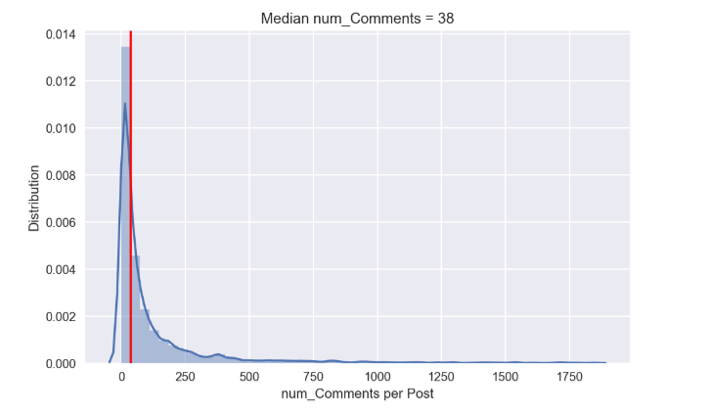
NUMBER OF COMMENTS = 38
it only takes only to engage readers is to hit the medium num of comments

Slide 6
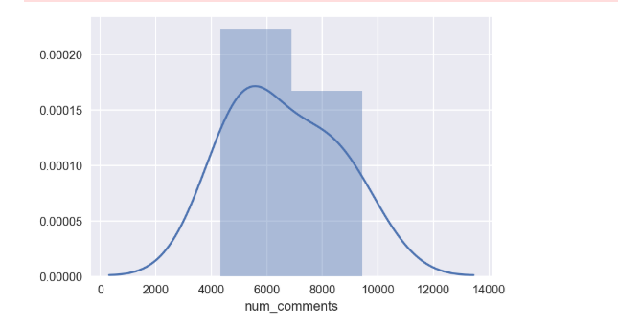
Distribution of comments with more than 4000 comments

Slide 7
WHAT IS THE TOPIC THAT HAVE MORE COMMENTS
1. Trump administration will put steel and aluminum tariffs on Canada, Mexico and the EU
2. What band/artist is the king of all of our songs sound the same,
3. What is something that you don’t appreciate you have until its gone
4. What the sluttiest thing you 've ever done
5. What's a good movie everyone should watch but almost no one has

Slide 8

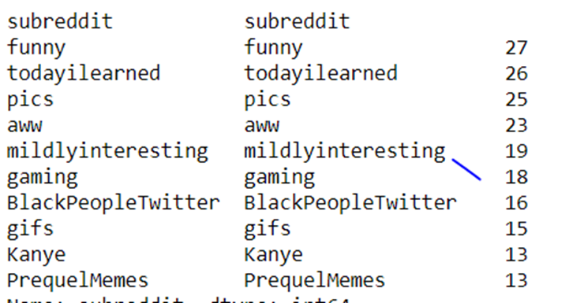
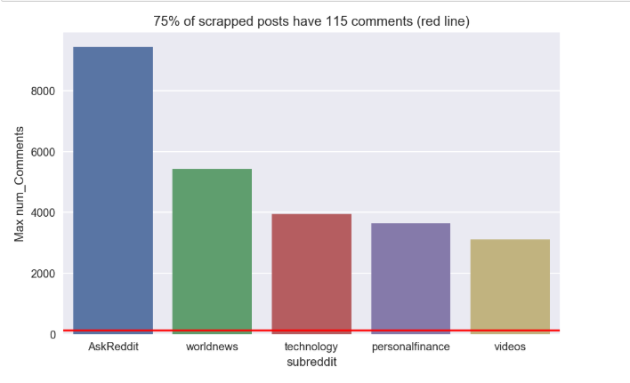
The subreddit comments
five subreddits, by max number of comments in each using the 75% of all comments

Slide 9
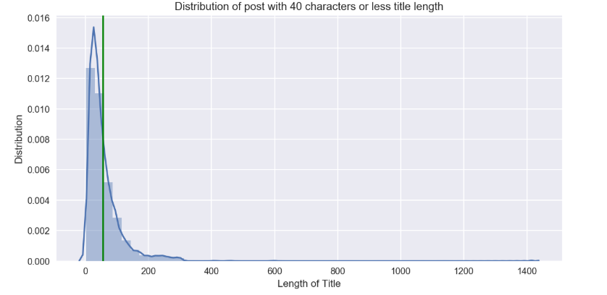
Average length of Titles with most comments

Slide 10
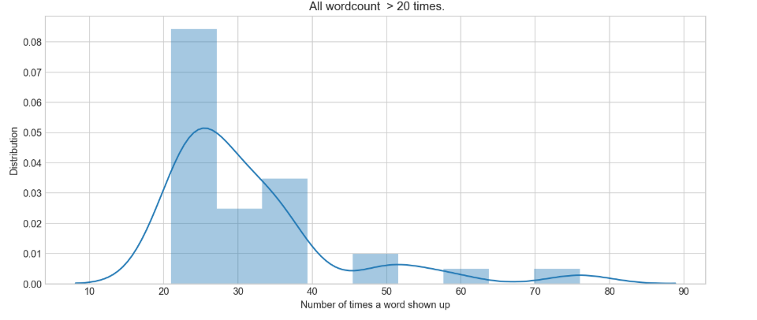
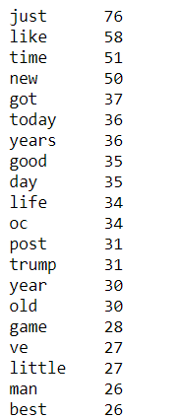
TOP MOST COMMON WORDS USED IN NUMBER OF COMMENTS

Slide 11
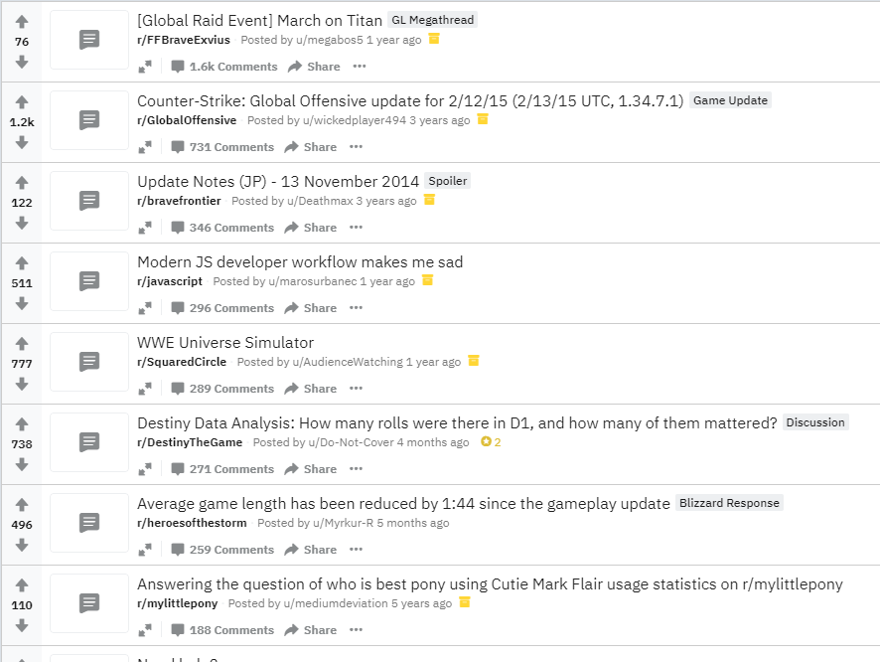


POSTS with Significant comments and low comments

Slide 12
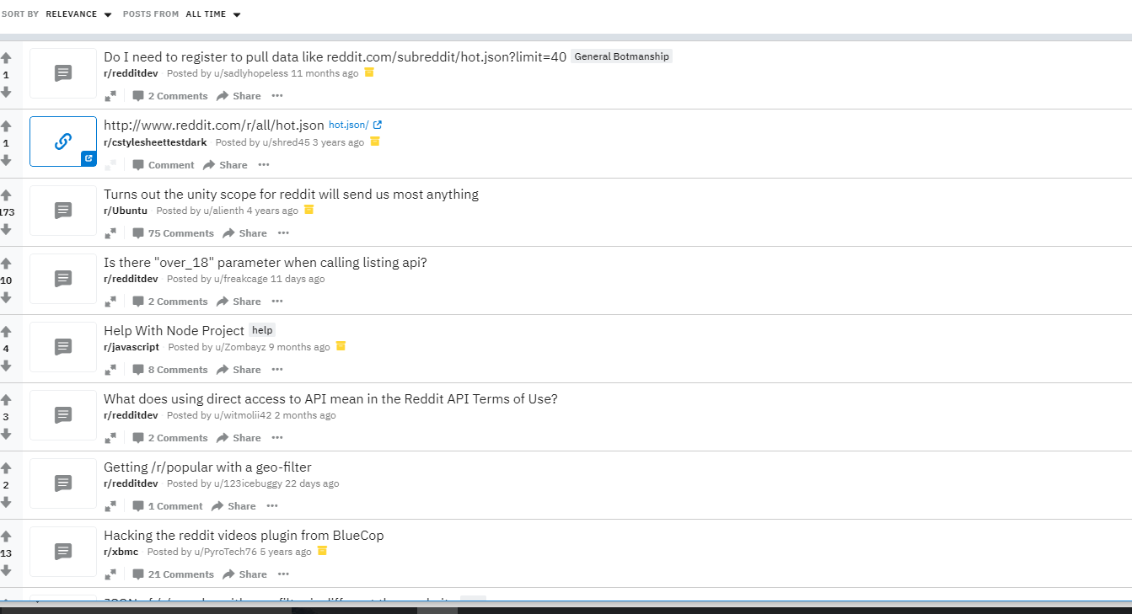
POSTS with Significant comments and low comments

Slide 13
MODEL
I used Bothe Random Forest Classifier and logistic regression classifier
Random Forest Score: 0.745 ± 0.016 for Training Data
Random Forest Score: 0.687 ± 0.023 for test Data
Logistic regressiion : 0.62

Slide 14
NEXT STEPS
Model accuracy score
Engineering additional Features
Grid search features
Collection of posts by time

Slide 15
THANK YOU

